Slide 1
Spring 2025 MEET THE COACHES NIGHT

Slide 2
Introductions
Kelli Braley- Athletic Director
Ben Arnold- Asst Athletic Director
Marcus Jones- Athletic Trainer
Arthur Maerlender, PhD, ABPP-CN Board Certified Clinical Neuropsychologist

Slide 3
Topics
Introductions
Values
Registration
Athletic Training
NHIAA/TCL Rules
Communication
Practices and Games
Schedules
Meet the Coaches

Slide 4
Our Vision and Mission
Interscholastic athletics are an extension of the classroom wherein our student-athletes learn valuable lessons that will help them as they progress through life.
The athletic department will establish strong working relationships with your student-athletes that will allow teaching and learning to flourish. To accomplish this, creating an environment of respect and support for both the athletic and academic endeavors of your student-athletes is essential. It is within this atmosphere that we will help to develop the youth of Amherst and Mont Vernon so that they will be able to make positive contributions to society.

Slide 5
Living Our Mission
Develop and maintain outstanding programs that produce championship results in the classroom and in life.
Stress the importance of academic achievement, the pursuit of and desire for knowledge, and progress towards graduation.
Expect the involvement of student-athletes in policy formation and execution and increase their personal interaction with the Department of Athletics staff.
Partner with the SAU and community to maintain and enhance facilities.

Slide 6
Core Values-Respect, Trust, Courage
Compassion, Accountability, Respect, Effort
1
Student-Athletes
2
Families
3
Coaches & Staff
Set the Right Example
Lead with integrity
Work Hard
Keep it positive
Officials
Appropriate Communication
Whole students
Officials
Conversations
Notes:
Respect: For school community follow expectations set forth by the Souhegan Cooperative and Amherst School Districts, their school, the Athletic department, and the sport-specific program in which they participate, For teammates and coaches- be fully committed. For opponents Student-athletes represent themselves, schools, families, and city. Unsportsmanlike behavior by students will have consequences.
Trust: Student-athletes have a responsibility to be leaders amongst their peers. We are trusting them to be representatives of our larger community on very public scenes. They have to demonstrate respect to their community, school, program, team, and self by behaving appropriately at all times. They are encouraged to excel in school and to make the right decisions in social settings and in peer groups.
Courage: Putting yourself out there in all situations can be a daunting endeavor. Every task, drill, practice, game, and homework assignment should be done with pride and excellence at all times; understanding that each individual’s level of excellence may be different.
For Families:
Respect: Keep the cheering positive, no profanity or degrading language or gestures. Appreciate good play from both sides. Learn the rules of the game to be a better/informed spectator.
Trust: Judgement calls of officials and coaches.
Courage: Encourage other spectators to participate in the spirit of good sportsmanship
** let the players play, the coaches coach and the officials officiate**
We have a ZERO tolerance policy for harassment of officials. It is a privilege for your kids to play sports and it is a privilege for you to be able to watch.
For Coaches:
Respect: Remember that our athletes are whole people; get to know them as such.
Trust: Judgement calls of the department and officials.
Courage: Have conversations when necessary.

Slide 7
Registration Steps
Online Registration through Powerschool
Proof of Medical Exam Clearing Student for athletic participation
ImPact Test (SHS ONLY)
Marcus will be in touch with coaches regarding athletes who still need this
Academic Eligibility
User Fee Payment
SHS- My School Bucks, click “stores,” then “show all.” Invoices are not created for athletics
AMS-Check to “Amherst Middle School” can be dropped off at the Main Office
Notes:
Students wishing to participate in high school interscholastic athletics must complete the following in order to be eligible. A student MAY NOT participate until all items are completed and verified.
1. Online registration through PowerSchool for each season of participation
During this registration process, the parent/guardian will
· give permission for participation and provide emergency and medical information
· provide proof of health insurance.
· accept policies, procedures, and expectations as outlined.
Opportunities will be provided for families to use a school computer if other internet access is not available.
2. Proof of medical examination clearing student for athletic participation
This is required once in the student’s high school career. It is required prior to participation at any level. For students new to high school athletics, the physical must be dated on or after July 1 of the previous year.
For example: for the 2019-20 school year the physical must be dated on or after July 1, 2018 (last summer).
If necessary, please see the Athletic Department for information regarding locations of free or inexpensive athletic physicals.
3. Academic Eligibility
4. Impact Testing for contact sports
All freshmen, juniors, and students new to high school athletics at Souhegan who wish to participate in a contact sport will need to take the computerized Impact test. This test will provide baseline data which will aid in the return to participation in the event of a head injury.
5. Athletic User Fee Payment
Athletic user fees can be paid online during the registration process or by cash or check delivered to the athletic office in the high school. Checks should be made payable to “SHS Activities”. There will be a $35 charge for all checks returned due to insufficient funds. Students may tryout prior to this fee being paid but students will not be issued a uniform until the fee is settled (ie: paid, free/reduced lunch or financial hardship granted, family cap, 3-season athlete verified, or payment plan agreed to). Dual sport athletes (two sports in one season) are required to only pay the higher of the two fees.
Fee Waivers
· Students who qualify for free or reduced meals through the Food Services Program are exempt from athletic fees and should indicate this at the time of registration.
· Any student-athlete who is a three-season participant in good standing in the same school year will not be charged the user fee for the spring season.
· No family will be required to pay more than $400 in any single school year. Hockey does not count towards cap.
A fee waiver or payment plan may be requested if there are extenuating circumstances regarding financial hardship. This request can be made during the online registration process.

Slide 8
Athletic Training
Contact information
Email: souheganatc@sau39.org
Office Hours
1:00 pm to 4:00 pm.
Do not leave during class to get treatment.
Do not wait until practice begins to get treatment.
Impact Testing
Concussions/Return to play protocol

Slide 9
NHIAA Policies for High School Athletes
Age (NHIAA By-Law Article II Section 1)
Academic Eligibility (NHIAA By-Law Article II Section 2)
Eight Semester Rule (NHIAA By-Law Article II Section 3)
Transfer Students (NHIAA By-Law Article II Section 4)
Non-School Competition (NHIAA By-Law Article II Section 7)
Notes:
Age (NHIAA By-Law Article II Section 1)
A student must be less than 19 years of age prior to September 1 of the current school year.
Scholastic Standing A. No pupil who has failed to pass four (4) units of work* during the school’s previous grading period** shall represent the school in any interscholastic contest. A minimum of four (4) units of work per grading period is required for participation in interscholastic athletics
Eight Semester Rule (NHIAA By-Law Article II Section 3)
A student shall be eligible for interscholastic high school competition for no more than eight consecutive semesters beyond the eighth grade. This rule applies regardless of participation in athletics during that time.
Transfer Students (NHIAA By-Law Article II Section 4)
The rules governing transfer students entering the Nashua School District from another school are governed by the NHIAA. Students who transfer into the Nashua School District must be declared eligible prior to participating in a contest. Information regarding the athletic eligibility of all students transferring to the Nashua School District should be requested from the Athletic Department Office.
Non-School Competition (NHIAA By-Law Article II Section 7)
Members of a school team are prevented from missing any portion of a high school practice or competition to practice or compete with an out-of-school team. This includes non-school tournaments, showcases, combines, or other athletic events. Whenever a conflict arises between the high school team practice/competition and an out-of-school practice/competition on the same day, the high school team practice/competition must be honored by the student-athlete. Priority must be given at all times to the high school team, its practices, and its contests unless a waiver has been granted by the principal and athletic director. It is expressly understood that waivers shall not be granted on a regular basis and shall only be granted in extraordinary circumstances.
Penalties: Any student-athlete who violates this rule, unless a waiver has been granted, for the first time shall be declared ineligible for the next four (4) consecutive interscholastic events or three (3) weeks of a season in which the student-athlete is a participant, whichever is greater. This Penalty is effective from the date of his or her last participation in a high school sport. Any student-athlete who violates this rule a second or subsequent time shall be declared ineligible for participation in any high school sport for the balance of the school year.

Slide 10
TCL Policies for Middle School Athletes
Player Eligibility
Upon entering fifth grade, a student is eligible for competition (whether or not he/she competes) for no more than four consecutive years.
Home-educated, non-public, charter school students
A home educated student may represent a charter school, non-public or public school in the district where they reside. The home educated student must be living with the parents or legal guardians in the family residence.
A non-public and charter school student may represent the non-public or charter school they attend or the public school in the district where they reside. The non-public or charter school student must be living with the parents or legal guardians in the family residence.
School Representation
A student is eligible to represent only one (1) school in any academic year, unless a legal change of residence has occurred.
For students participating in clubs/AAU etc. the school team shall be the priority and missing any portion of a middle school practice or competition to practice or compete with an out-of-school team may result in dismissal from the school team.

Slide 11
Athletic Guidelines
Go to Class on Time
Being absent and/or excessively tardy will impact your ability to participate in athletics
Do your Work
Daily Team Attendance
It is expected that once a season begins (first day of practice or tryouts), a student will be in attendance at every tryout, practice, competition, and team event.
Uniform Return
Bring to Banquet/Team Celebration at end of season, coaches will collect. Not returning means no uniform next time.
Parking
Only in actual parking spots. Please do not park on Simeon Wilson Rd.

Slide 12
Communication
Parent and Student athlete
Student Athlete and Coach
Parent and Coach
24 hour rule: never before, during or after a practice or game.
Student Athlete, Parent, Coach and Athletic Director
Contact the Athletic Director immediately in the case of an emergency or a severe violation of safety.
Notes:
While interscholastic athletics can provide some of the most rewarding and inspiring moments in students’ lives, there can also be times when things may not go the way a parent or child wishes. If a conflict or issue arises during a season, it is imperative that it be addressed in a timely and appropriate manner so that the concern can be resolved promptly. Both parenting and coaching are extremely difficult jobs. Open communication and clear expectations will enable both groups to work together to provide a greater benefit to the student-athletes.
In many instances, a conversation between a parent and the student-athlete can resolve most questions or concerns. The student-athlete who is in attendance daily at practices and games should be able to address rules and roles of the program.
If this conversation does not resolve the problem or answer the question, the next step is for the student-athlete and coach to discuss the concern. Many times a misunderstanding can easily be resolved with this direct conversation.
If it is necessary for a parent and coach to meet to discuss a concern, the parent should contact the coach to schedule a meeting. Please do not attempt to confront a coach before, after, or during a practice or game. These can be emotional times for both the parent and the coach and would not promote a positive resolution. It should be understood that playing time, team strategy, play calling, and other student-athletes are not topics of discussion.
If none of the above avenues resolve the concern, then a meeting between the student, parent, coach, and Athletic Director will be scheduled.

Slide 13
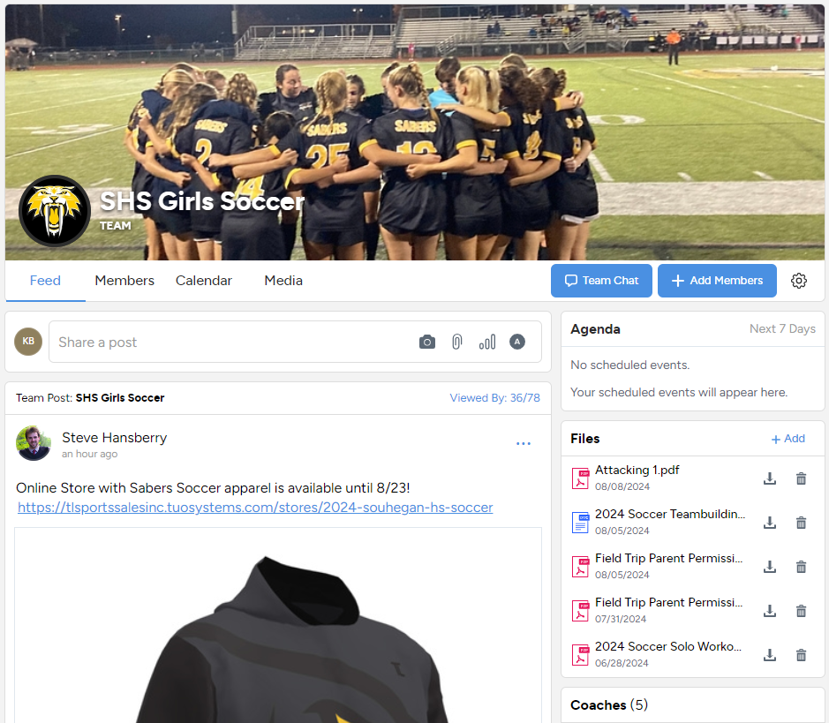
SportsYou
1 stop spot for all Communications for all teams
Schedules
Updates
Changes
Pictures
Forms
Scan the QR Code in your Team Rooms to join

Slide 14
Practices and Games/Meets
SHS Practices begin no earlier than 3:45pm, AMS practices begin as close to 3:30pm as possible.
Games/Meets will vary.
Travel
Transportation To and From Contests: The school strikes to provide bus transportation, or a suitable substitute, to and from most “away” contests. All team members are expected to travel to these contests using the school provided transportation in order to compete in the event. Exceptions will be made to this rule in only the most necessary cases. A student-athlete who does not ride the bus with the team without prior approval will not participate in the event.
Notes:
Parents wishing to transport their child home from an away event must notify the athletic office before the end of school (2:00pm) the previous school day. For example – for a Friday game notification must be given by 2:00pm on Thursday. For a Saturday, Sunday or Monday event, notification must be given by 2:00pm on Friday. Please understand that coaches are permitted to require all team members to be on the bus on the way home.

Slide 15
Reminders
Parent / guardian communication with school staff is vital. For the success of our players and coaches, please reach out to the athletic department anytime you have a question or concern.
Kelli: kbraley@sau39.org or call 673-9940 x5331
Ben: barnold@sau39.org or call 673-9940 x5330
Marcus: souheganatc@sau39.org
Notes:
Things can change quickly with regard to schedule, transportation and opponent protocols.

